Slide 1

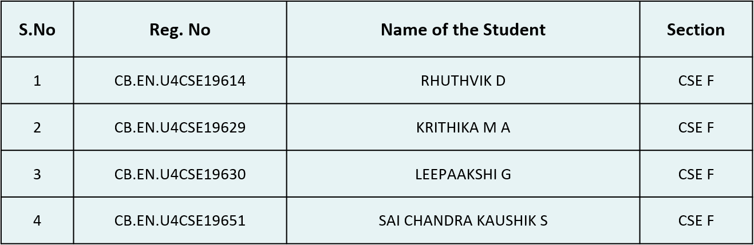
Body Part Classification From X-ray Images
Phase 2 –Final Review ; June 1st ,2023
Group Number : 49 Panel Number:4(CVIP)
Team Members
Project Advisor: Dr. Raghesh Krishnan K / Asst. Professor / CSE

Slide 2
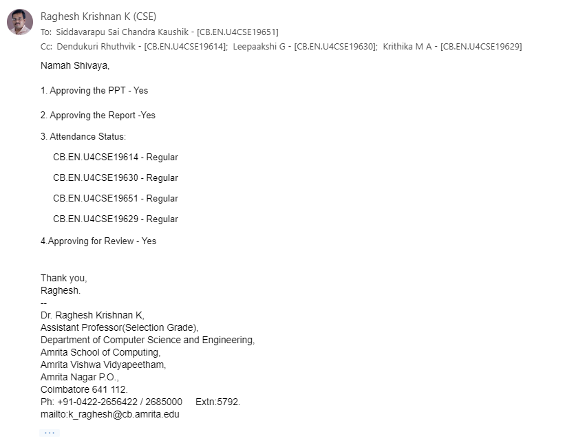
Guide Approval

Slide 3
OBJECTIVE
To classify Body Parts from X-ray images
Facilitates accurate medical image retrieval and clustering applications.
Automatic categorization of x-rays to facilitate easier medical data warehousing.
Easier to implement organ specific model pipelines by retrieving data.
Use of such system can find its role in developing medical software.

Slide 4
PROBLEM STATEMENT:
CLASSIFYING DIGITAL X-RAY IMAGES INTO DIFFERENT HUMAN BODY PARTS USING DEEP LEARNING

Slide 5
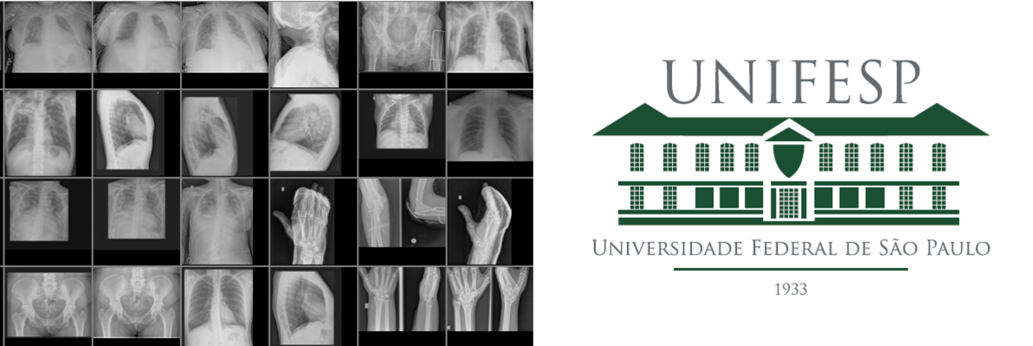
DATASET DETAILS
UNIFESP X-ray Body Part Classification dataset
https://www.kaggle.com/competitions/unifesp-x-ray-body-part-classifier/data
1688 annotated DICOM images with a unique SOP Instance ID.
23 Classes
There are more than 700 images pertaining to chest x-rays while infrequently classified classes have lesser images like clavicle or skull, etc.
Highly imbalanced dataset.

Slide 6
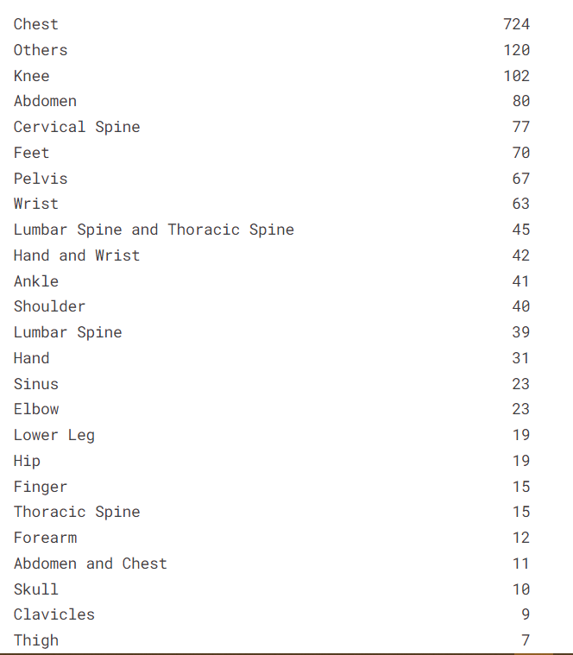
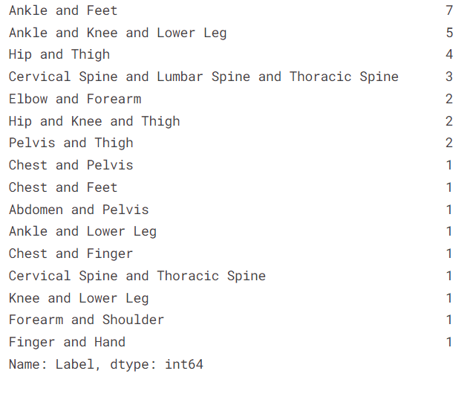
DATASET DETAILS

Slide 7
LITERATURE SURVEY
S. No | Title | Category | Year of publish | Dataset | Inference
1 | A NOVEL DATA AUGMENTATION BASED ON GABOR FILTER AND CONVOLUTIONAL DEEP LEARNING FOR IMPROVING THE CLASSIFICATION OF COVID-19 CHEST X-RAY IMAGES | Journal | 2022 | 4560 X-RAY images 4200 – images regarding other diseases 360 – images with COVID | Resolved the data limitation problem by combining the traditional data augmentation techniques with the GAN, also added a deeper extraction of features by applying different filter banks (Gabor filter) ;Accuracy: 91%
2 | DICOM IMAGING ROUTER: AN OPEN DEEP LEARNING FRAMEWORK FOR CLASSIFICATION OF BODY PARTS FROM DICOM X-RAY SCANS | Journal | 2021 | 16093 DICOM X-RAY images 11263 – training images 2419 – testing images | MobileNet-V1 – 98.1% precision ResNet -18 – 93% precision EfficientNet-B0 – 97.7% precision
3 | AUTOMATIC CLASSIFICATION OF MEDICAL X-RAY IMAGES WITH CONVOLUTIONAL NEURAL NETWORKS | Journal | 2020 | 14410 X-Ray greyscale images 12677 – training images 1733 – testing images 193 classes of different modality and orientation | Using InceptionV3, the accuracy is 68.67% and loss is 1.442 with no padding. The accuracy is 71.34% and loss is 1.608 with padding.

Slide 8
LITERATURE SURVEY
S. No | Title | Category | Year of publish | Dataset | Inference
4 | COMPARISON OF HANDCRAFTED FEATURES AND DEEP LEARNING IN CLASSIFICATION OF MEDICAL X-RAY | Journal | 2018 | ImageCLEF 2007 116 classes of different modality and orientation. | BoVW+SVM – 24 classes showed accuracy above 80% AlexNet+SVM - 26 classes showed accuracy above 80% Fine Tuned AlexNet – 60 classes showed accuracy above 80%
5 | AN ENSEMBLE OF FINE-TUNED CONVOLUTIONAL NEURAL NETWORKS FOR MEDICAL IMAGE CLASSIFICATION | Journal | 2016 | ImageCLEF 2016 10932 images 6766 – training images 4166 – testing images 30 classes | Fine-tuned AlexNet with softmax classifier – 79.62 Fine-tuned GoogLeNet wit softmax classifier – 77.17
6 | X-RAY IMAGE CLASSIFICATION USING DOMAIN TRANSFERRED CONVOLUTIONAL NEURAL NETWORKS AND LOCAL SPARSE SPATIAL PYRAMID | Conference | 2016 | N/A | Fusion of Domain Transferred CNN and SSP gave an error of 159. DT-CNN had a recall of 47% and SSP had recall of 82%. Their fusion had a recall of 86%

Slide 9
LITERATURE SURVEY SUMMARY
“A NOVEL DATA AUGMENTATION BASED ON GABOR FILTER AND CONVOLUTIONAL DEEP LEARNING FOR IMPROVING THE CLASSIFICATION OF COVID-19 CHEST X-RAY IMAGES” journal 2022
It is a latest approach that provides best accuracy for classification of X-ray images considering an imbalanced dataset.
This resolves the data limitation problem by combining the traditional data augmentation techniques with the GAN.
Also added a deeper extraction of features by applying different filters, namely Gabor Filter, Sobel Filter, etc.

Slide 10
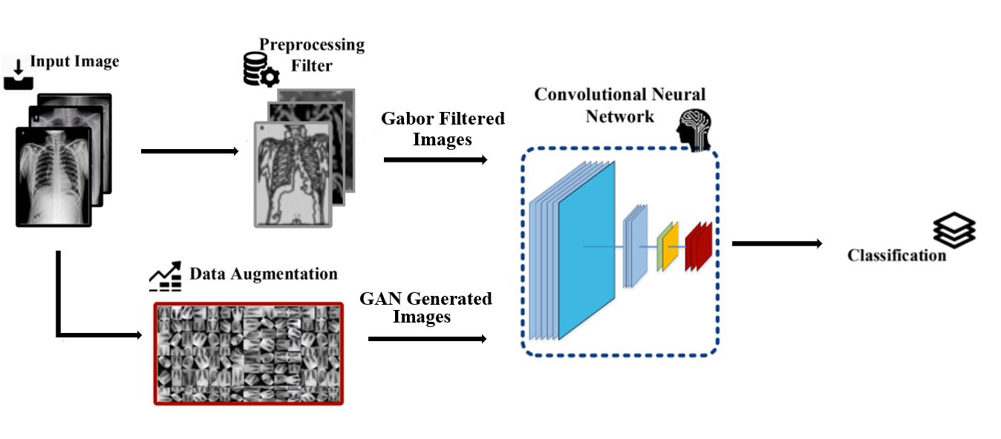
ARCHITECTURE DIAGRAM

Slide 11
MODULES AND EXPLANATION
Data Augmentation
Set of methods used to increase the amount of data by generating new data from existing data.
Improves model performance by adding new data to the training set, helps in achieving better accuracy.
Easier and cost effective, collecting and labelling data is costly and exhausting
Done by applying various transformation techniques such as rotation , flipping, scaling to the existing data. (Traditional techniques)
Models can learn features that are invariant to transformation using data augmentation.

Slide 12
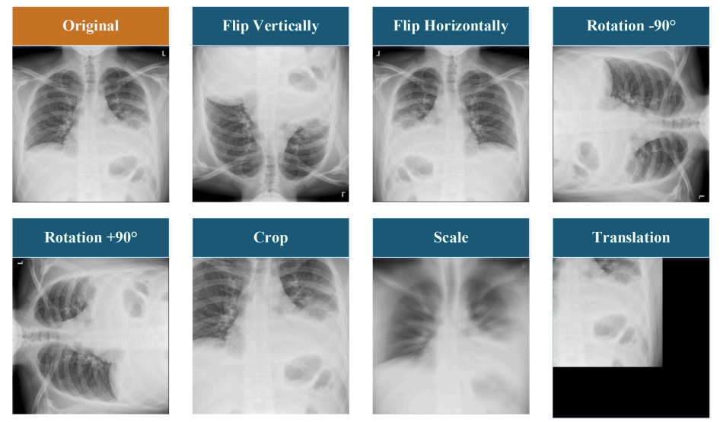
Traditional Data Augmentation :

Slide 13
GAN Augmentation
Generative Adversarial Network is a generative modeling approach. GAN takes two neural networks to compete in the form of a zero-sum game to give predictions more accurately.
These two neural networks are called the generator and the discriminator
The generator is a convolutional neural network that works to fool the discriminator by artificially producing outputs.
The discriminator is a deconvolutional neural network responsible for telling how realistic the input seems, which gets updated dynamically.
Total : 1688 (original images) + 64*19 (generated) = 2904 images

Slide 14
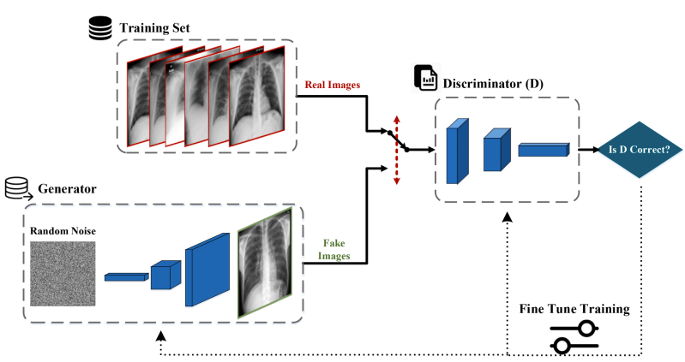
GAN Structure

Slide 15
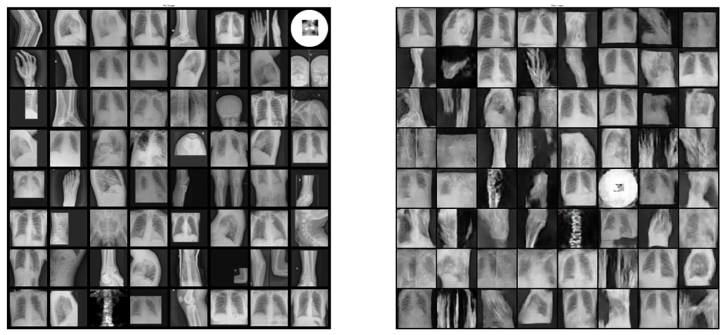
GAN on whole raw dataset:
Epochs : 350
Number of images generated: 64 images per class

Slide 16
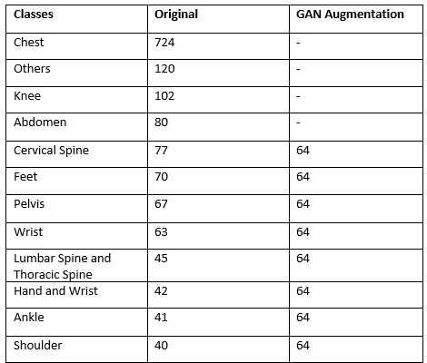
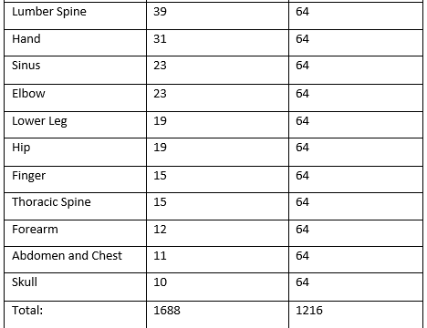
GAN Generated Images per class:

Slide 17
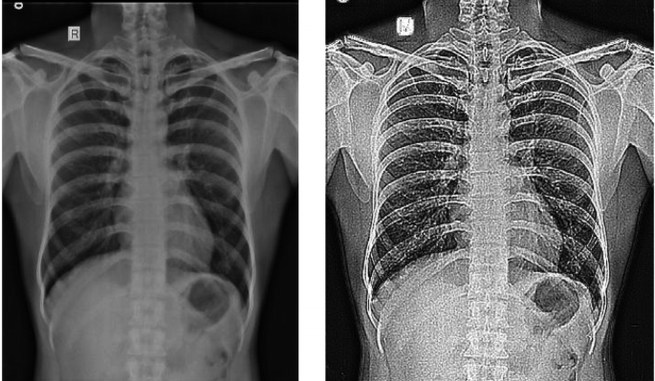
Gabor Filter
The Gabor filter feature extraction process starts with the application of a two-dimensional Gabor filter which is applied to each image individually. The process is guided by Gabor's uncertainty principle.

Slide 18
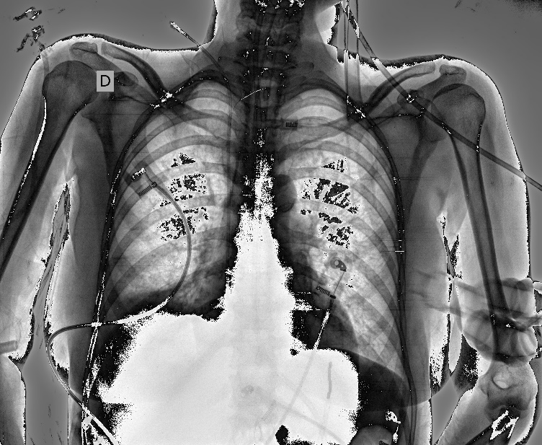
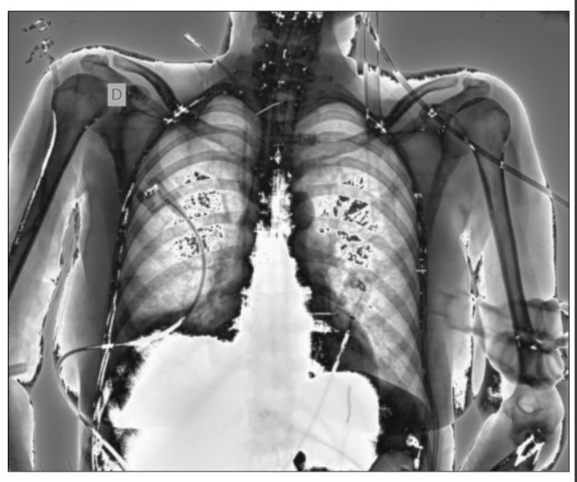
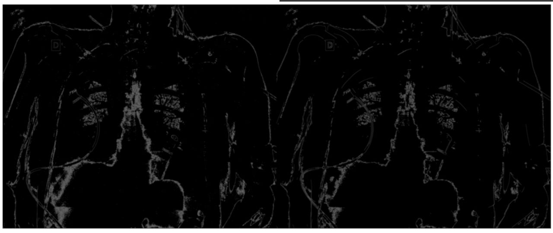
Gabor Filter and edge detector:
With lambda-10, sigma-3, gamma-0.5, we get the following image
For understanding the filtered image, we detect the edges, so the images can be differentiated.

Slide 19
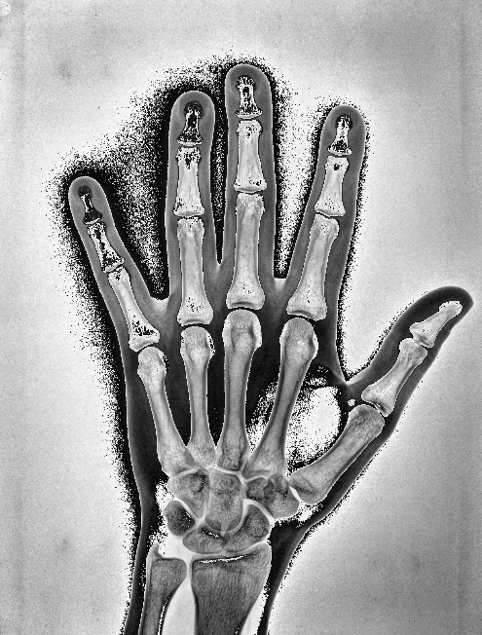
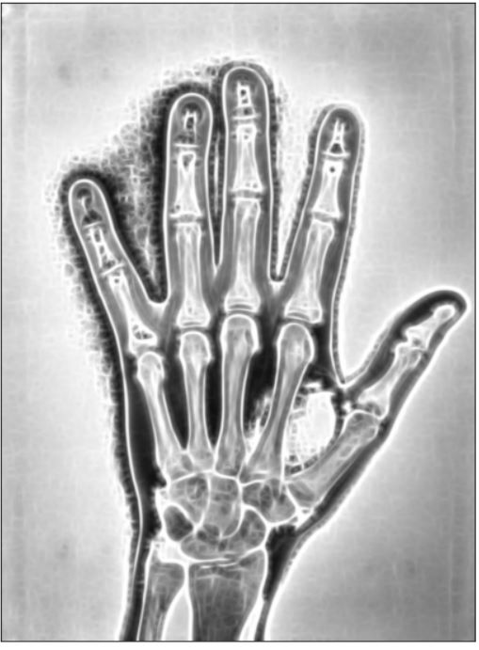
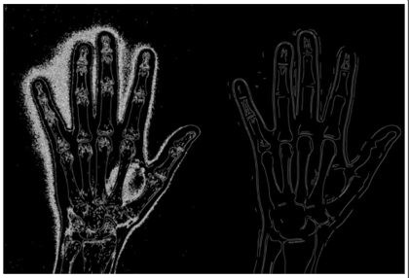
Gabor Filter and edge detector:
With lambda-30, sigma-10, gamma-0.5, we get the following image. Increasing the lambda and sigma, the image gets a little blurred and the bandwidth of the image increases.

Slide 20
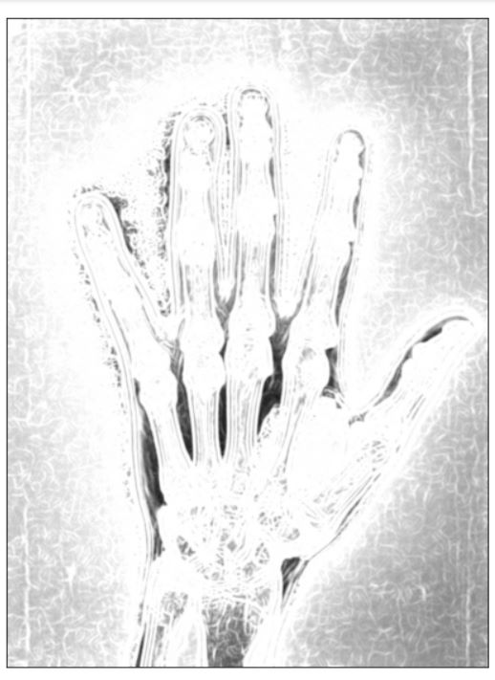
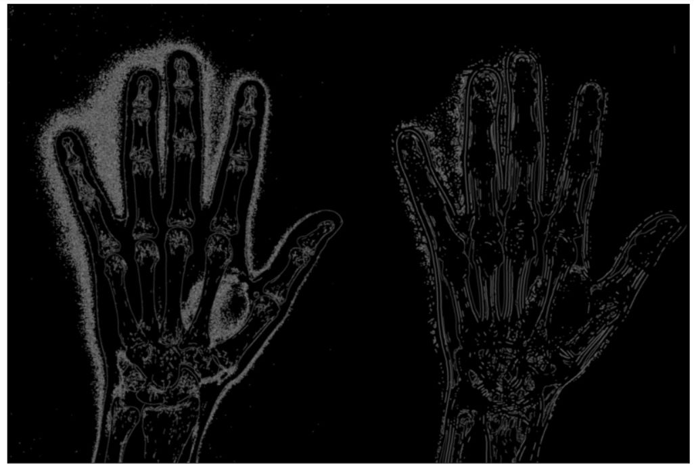
Gabor Filter and edge detector:
With lambda-30, sigma-20, gamma-0.75, we get the following image. Increasing the sigma, the image gets blurred and gets brighter. With this setting, we can find the edges more evidently. More the sigma, more the edges can be detected.

Slide 21
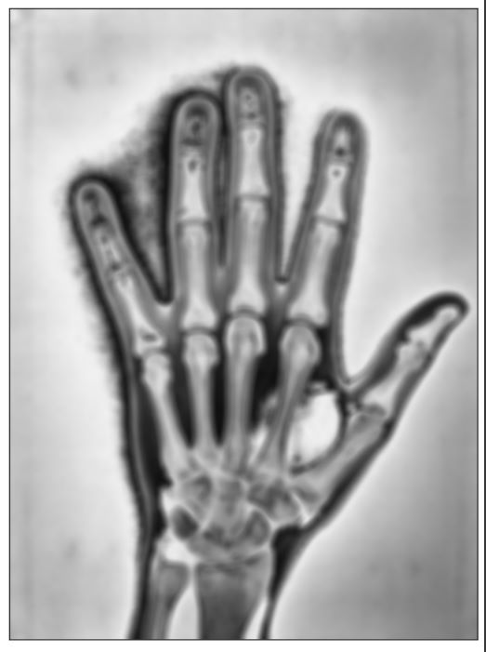
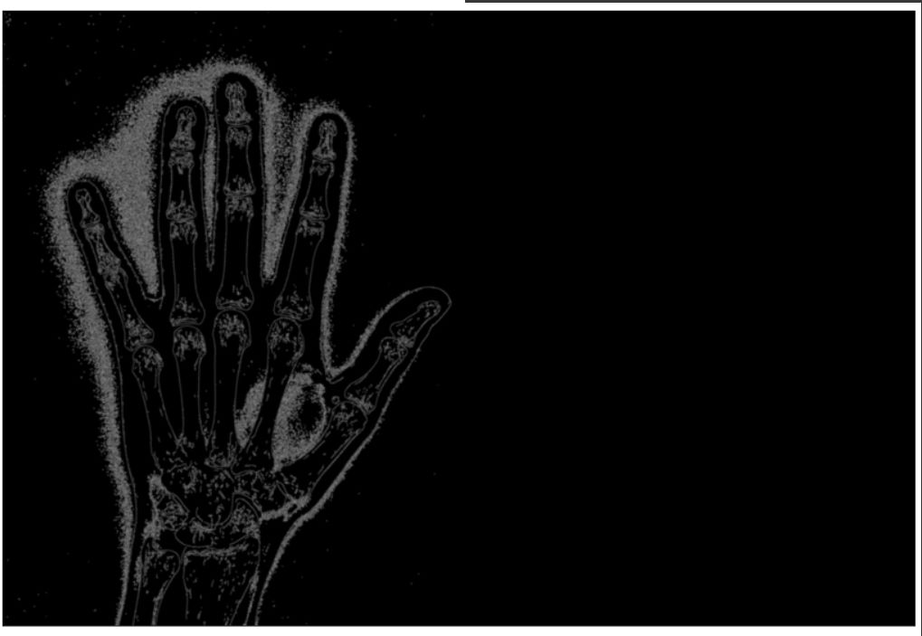
Gabor Filter and edge detector:
With lambda-70, sigma-20, gamma-0.75, we get the following image. Increasing the lambda, the image gets blurred a lot. With this setting, we cannot find the edges as the image is smoothened. More the lambda, lesser the edges can be detected.

Slide 22
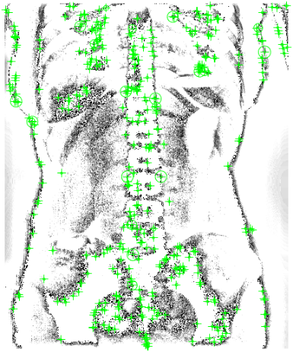
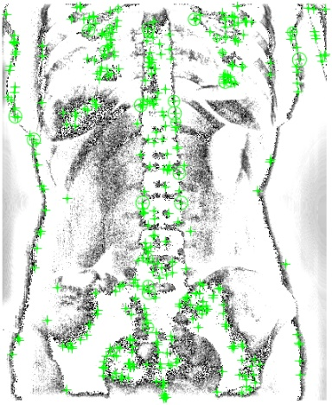
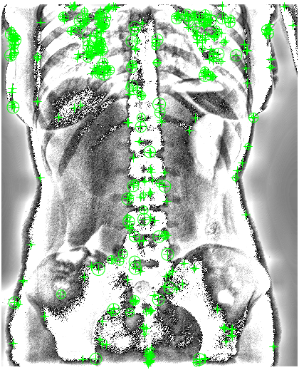
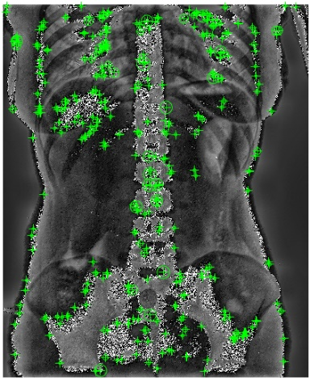
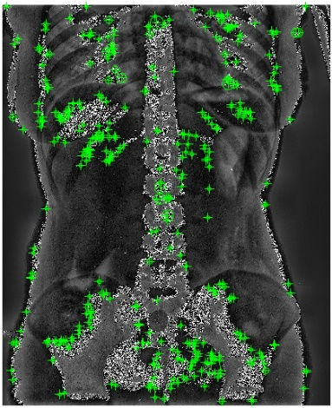
SURF on selected Gabor filtered Images using selectStrongest(400) descriptors:
Gabor-11 – theta=0,sigma=3,lambda=pi/4,gamma=0.05
Gabor12 – theta=0,sigma=3,lambda=pi/4,gamma=0.5
Gabor29-theta=pi/4,sigma=1, lambda=pi/2,gamma=0.05
Gabor31 –theta=pi/4,sigma=1, lambda=pi/2,gamma=0.05
Gabor 37-theta=pi/4,sigma=3, lambda=pi/2,gamma=0.05
Notes:
Add gabor for all parts, best gabor selected is not Gabor 37.. As only the required bones are noised up due to which the necessary structure is concentrated on. Gabor29 is also not a better option. But Gabor 11,12, 31 are lots of noises. Duee to which key features are captured.

Slide 23
Classification models

Slide 24
Convolutional Neural Network
Learns and extract features from images effectively.
Learn invariant features using its pooling layers.
Prevents overfitting as the number of parameters the model learns is reduced using convolutional and pooling operations.
Learns all possible features efficiently using its convolutional layer which applies filters to local regions of the data.
Achieved state-of-the-art results in many image recognition tasks.

Slide 25
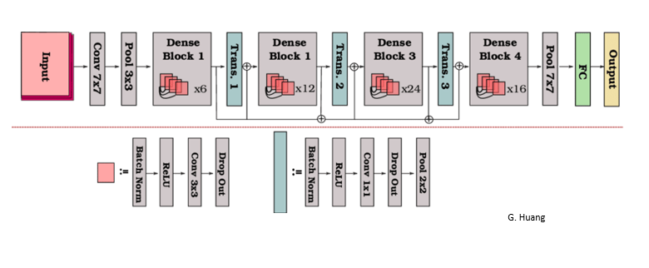
DenseNet121
Architecture:

Slide 26
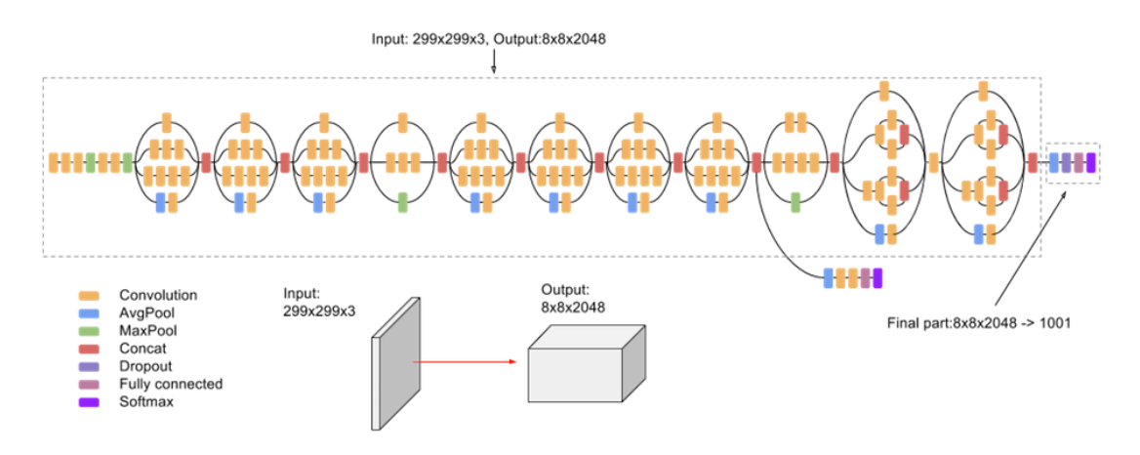
InceptionV3
Architecture:

Slide 27
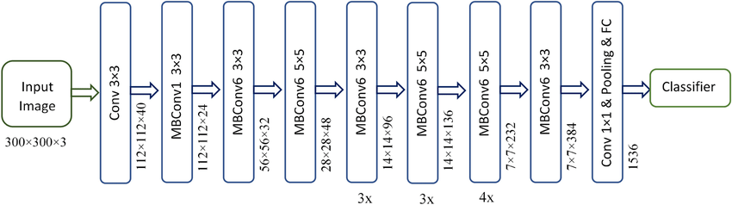
EfficientNetB3
Architecture:

Slide 28
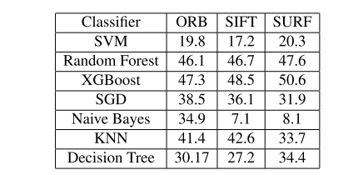
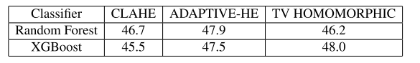
Results Comparison

Slide 29
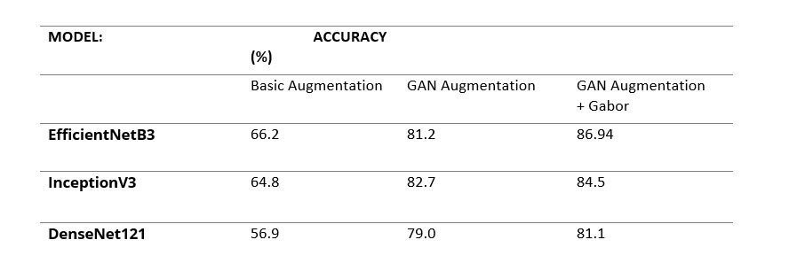
Results Comparison

Slide 30
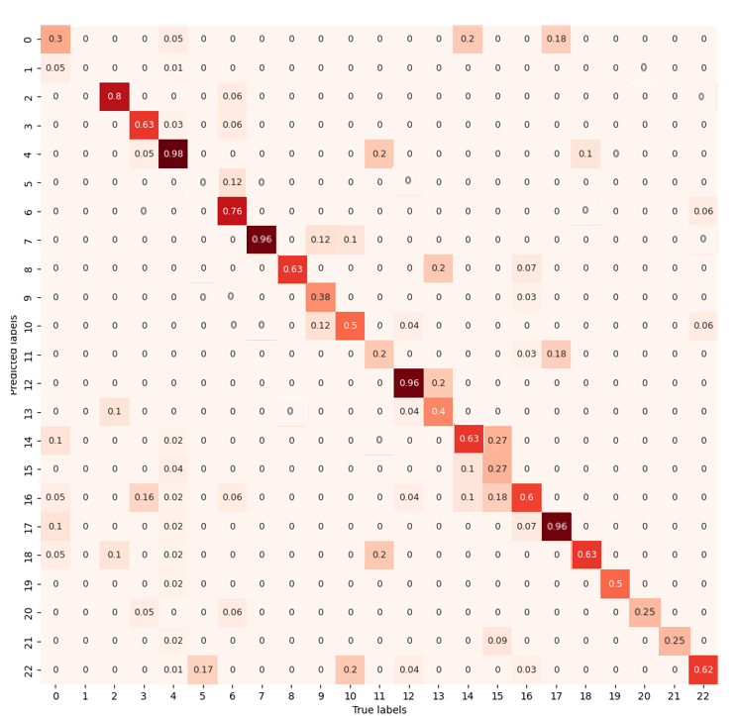
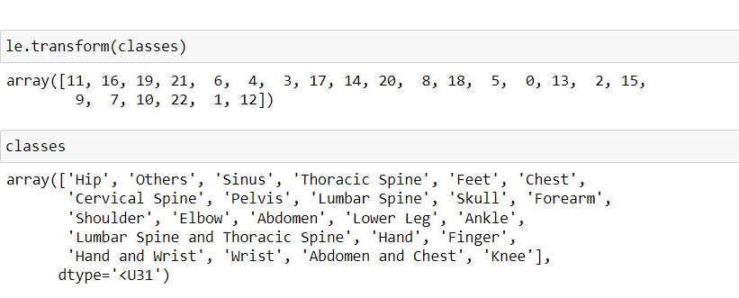
EfficientNetB3 Confusion Matrix Summary
As seen, there are some misclassifications that occurred.
Some of the images from the class ”Lumbar Spine and Thoracic Spine” are being misclassified as “Chest”. This has the highest misclassification recorded.
Similarly, some images from the class “Hip” are being misclassified as “Shoulder”.
Very few images from “Chest” are being misclassified into the class “Hand and Wrist”.
The classes “Elbow” and “Abdomen and Chest” are not being classified as there are 0 in their corresponding places.

Slide 31
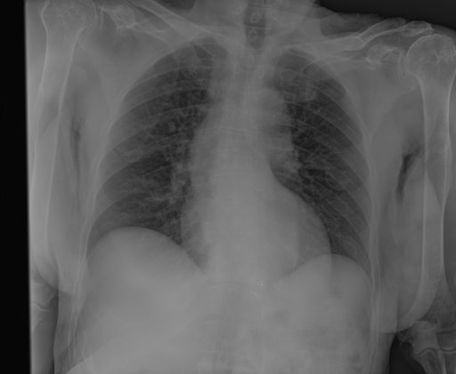
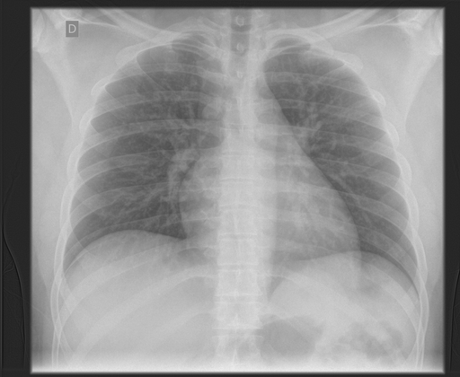
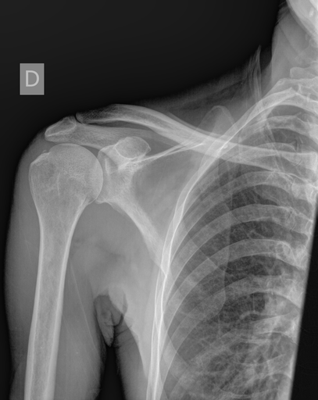
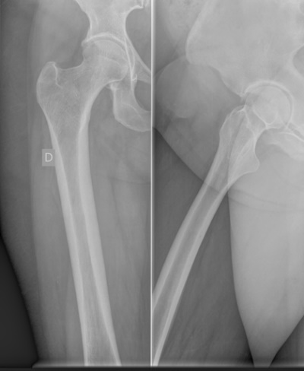
Misclassification Examples
Class: Lumbar Spine and Thoracic Spine
Class: Chest
Class: Hip
Class: Shoulder

Slide 32
Conclusion
From the experimented models, Gabor filtered images with GAN augmentation classified by EfficientNetB3 provided the best accuracy of 86.94%.
There are misclassifications due to inter-class similarity and intra-class variations.

Slide 33
Thank You

